Slide 3
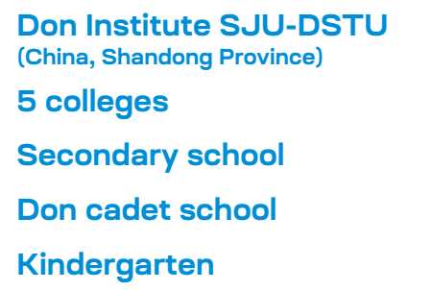

Slide 7
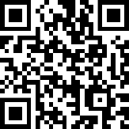

Slide 14
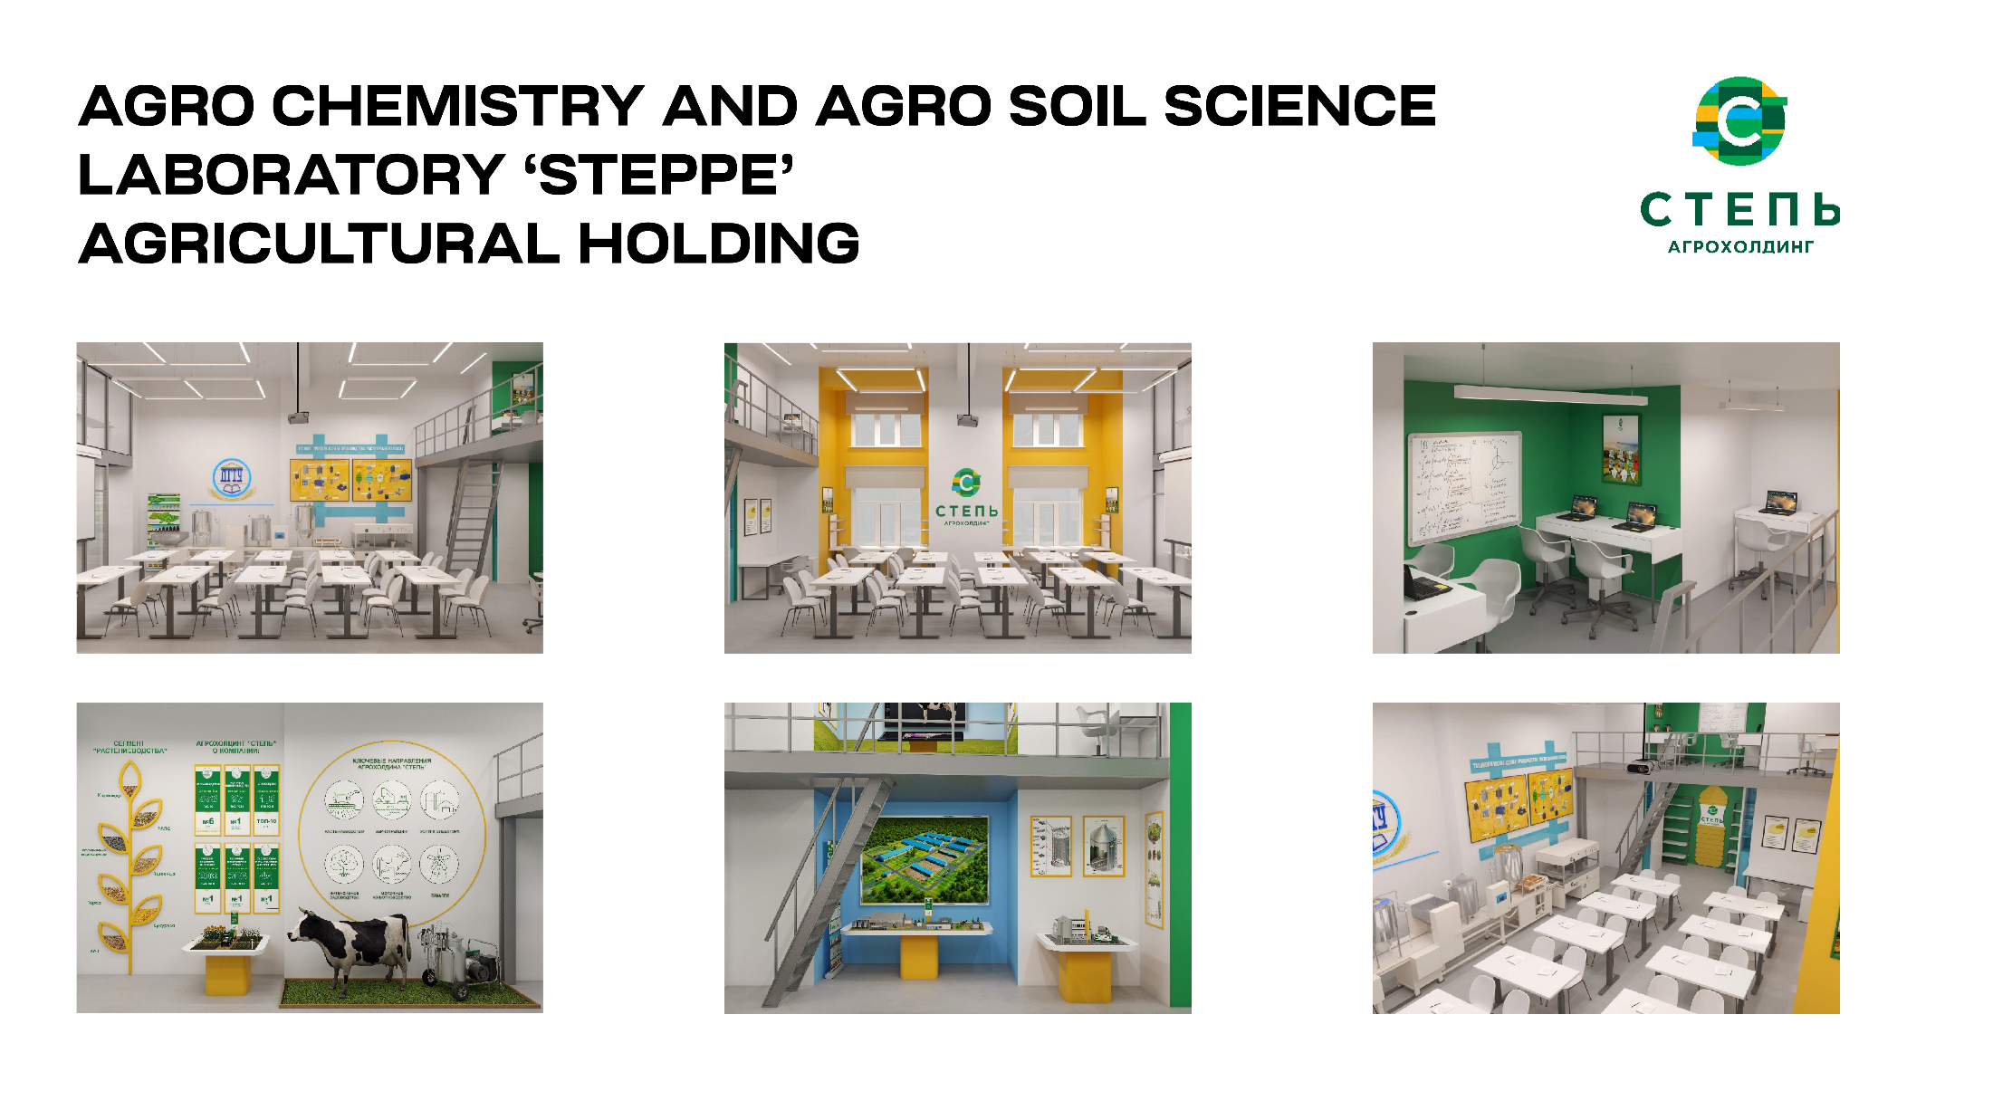

Slide 15
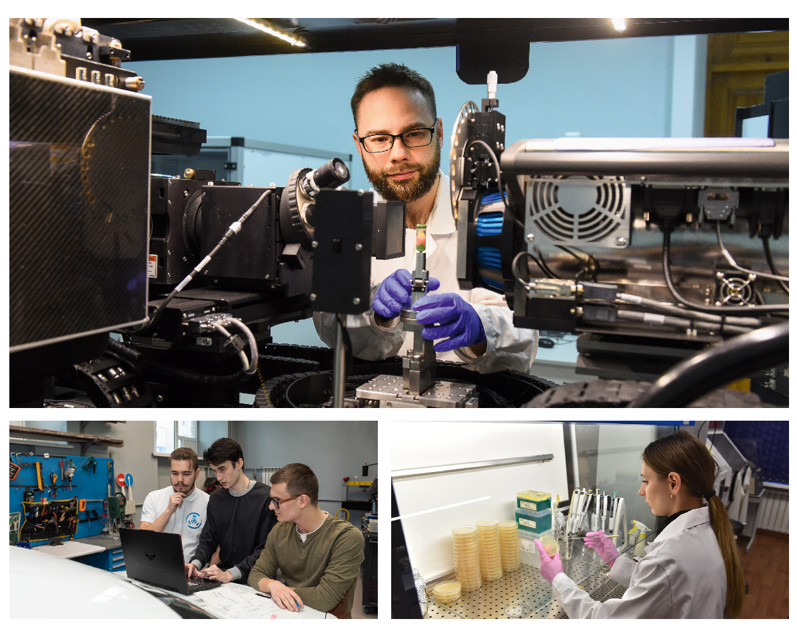

Slide 17
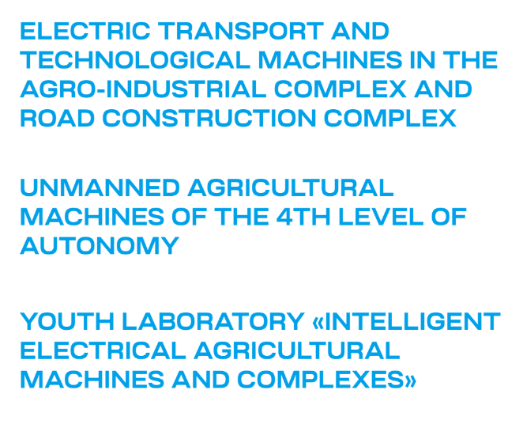

Slide 22
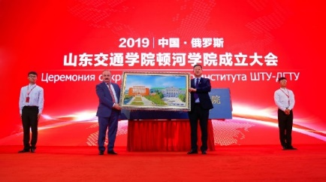
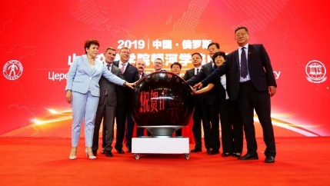
18.06.2019
JOINT EDUCATIONAL PROGRAMS
Construction of Bridges and Tunnels
Organization of Transportations and Transport Management
100 students
per program
Computer Science and Technology

Slide 28
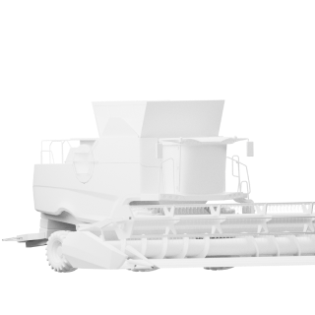
AGRIBUSINESS FACULTY
Bachelor’s programs
PARTNERS
Agriculture, Forestry and Fishery
Equipment and Technologies of Land Transport
Mechanical Engineering. Technological Machines and Equipment
Industrial Ecology and Biotechnologies
Long first degree programs (Specialist course)
Land Transportation and Technological Systems
Contacts
Master’s programs
Tel. +7 (863) 273-85-56
E-mail:→ spu-38@donstu.ru
Agro Engineering
Biotechnology
Food Products from Vegetable Raw Materials
Industrial Fishery
Land Transport and Technological Complexes
Water Resources and Aquaculture
PhD
Navigation Devices
Fishery, Aquaculture and Industrial Fishery
Technologies, Machines and Equipment for Agriculture

Slide 29
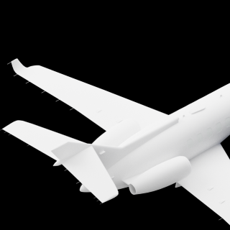
AIRCRAFT ENGINEERING FACULTY
Bachelor’s programs
PARTNERS
Aircraft Construction
Refrigeration, Cryogenics and Life Support Systems
Ground Transport and Technological Complexes
Technical Maintenance of Aircrafts and Aircraft Engines
Airport Management and Aircraft Flight Maintenance
Contacts
Master’s programs
Tel. +7 (863) 258-91-23
E-mail:→ spu-36@donstu.ru
Refrigeration, Cryogenic Engineering and Life Support System
Technical Maintenance of Aircraft and Aircraft Engines
Design and Technological Support for Machine-Building Industries
Mechanical Engineering
PhD
Navigation Devices
Aircraft Design, Construction and Production

Slide 30
ARCHITECTURE, DESIGN AND ART FACULTY
Bachelor’s programs
PARTNERS
Architecture
Reconstruction and Restoration of Architectural Heritage
Urban Planning
Construction
Design
Long first degree programs (Specialist course)
Monumental and Decorative Art
Contacts
Master’s programs
Tel. +7 (863) 201-94-72
E-mail:→ spu-57@donstu.ru
Architecture
Reconstruction and Restoration of Architectural Heritage
Architectural Environment Design
Urban Planning
Construction
Design
PhD
Theory and History of Architecture, Restoration and Reconstruction of Historical and Architectural Heritage
Architecture of Buildings and Structures. Creative Concepts of Architectural Activity
Urban Development and Rural Planning

Slide 31
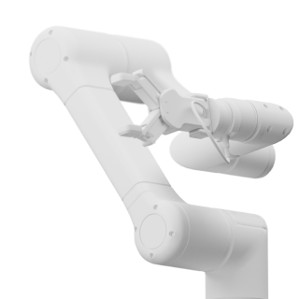
AUTOMATION, MECHATRONICS AND CONTROL FACULTY
Bachelor’s programs
PARTNERS
Applied Mathematics and Physics
Computer Science and Engineering
Electronics and Nanoelectronics
Photonics, Tool Engineering, Optical and Biotechnical Systems and Technologies
Power Engineering and Electrical Engineering
Automation of Technological Processes and Productions
Mechatronics and Robotics
High-tech Plasma and Energy Systems
Technical Systems Management
Innovation
Contacts
Tel. +7 (863) 273-86-38
E-mail:→ spu-37@donstu.ru
Master’s programs
Computer Science and Engineering
Technological Machines and Equipment
Automation of Technological Processes and Productions
Design and Technological Support for Machine-Building Industries
Mechatronics and Robotics
Control in Engineering Systems
Power Engineering

Slide 32
CIVIL AND INDUSTRIAL ENGINEERING FACULTY
Bachelor’s programs
PARTNERS
Construction
Long first degree programs (Specialist course)
Construction of High-Rise and Large-Span Buildings and Structures
Contacts
Tel. +7 (863) 201-91-04
E-mail:→ spu-52@donstu.ru
Master’s programs
Construction
PhD
Building Design, Buildings and Constructions

Slide 33
BIOENGINEERING AND VETERINARY MEDICINE FACULTY
Bachelor’s programs
PARTNERS
Nanoengineering
Zootechnics
Long first degree programs (Specialist course)
Veterinary Medicine
Pharmacy
Bioengineering and Bioinformatics
Master’s programs
Contacts
Nanomaterials
Veterinary and Sanitary Expertise
Biology
Tel. +7 (863) 238-13-09
E-mail:→ spu-45@donstu.ru
PhD
Bioorganic Chemistry
Molecular Biology
Biomechanics and Bioengineering
Biophysics
Mathematical Biology and Bioinformatics
Veterinary Pathology, Morphology, Physiology, Pharmacology and Toxicology
Veterinary-Sanitary Expertise, Ecology and Hygiene
Infectious Diseases and Immunology of Animals
Private Zootechnics Feeding, Feed Preparation and Livestock Production Technologies
Breeding, Selection, Genetics and Biotechnology of Animals

Slide 34
IT-SYSTEM AND TECHNOLOGIES FACULTY
Bachelor’s programs
PARTNERS
Mathematical Support and Administration of Information Systems
Computer Science and Engineering
Information Systems and Technologies
Applied Computer Science
Software Engineering
Information Security
Applied Mathematics
Long first degree programs (Specialist course)
Contacts
Information Security of Telecommunications Systems
Computer Security
Tel. +7 (863) 273-86-28
E-mail:→ spu-46@donstu.ru
Master’s programs
Mathematical Support and Administration of Information Systems
Information Security
Computer Science and Engineering
Information Systems and Technologies
Applied Computer Science
Software Engineering
Applied Mathematics
PhD
Mathematical Modeling, Numerical Methods and Software Systems
System Analysis, Management and Information Processing
Information Technology and Computer Science

Slide 35
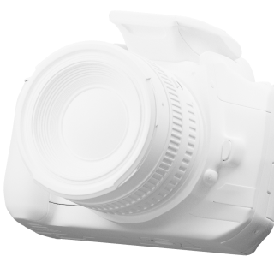
MEDIA COMMUNICATIONS AND MULTIMEDIA TECHNOLOGIES FACULTY
Bachelor’s programs
PARTNERS
Advertising and Public Relations
Media Communications
Applied Computer Science
Social and Cultural Activity
Folk Art Culture
Popular Music Art
Contacts
Tel. +7 (863) 238-13-49
E-mail:→ spu-49@donstu.ru
Master’s programs
Applied Computer Science
Media Communication
Advertising and Public Relations
Social and Cultural Activity
Vocal Arts
Design

Slide 36
POWER ENGINEERING, OIL AND GAS INDUSTRY FACULTY
Bachelor’s programs
PARTNERS
Applied Mathematics and Physics
Power Engineering and Electrical Engineering
Technological Machines and Equipment
Automation of Technological Processes and Productions
Chemical Technology
Contacts
Master’s programs
Tel. +7 (863) 258-91-09
E-mail:→ spu-58@donstu.ru
Power Engineering and Electrical Engineering
Technological Machines and Equipment
Automation of Technological Processes and Productions
Chemical Technology
PhD
Electrical and Thermal Engineering

Slide 37
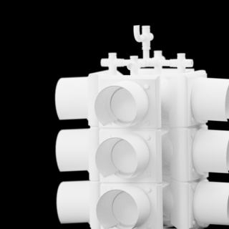
ROAD TRANSPORT ENGINEERING FACULTY
Bachelor’s programs
PARTNERS
Construction
Land Surveying and Cadastre
Geodesy and Remote Sensing
Transport Process Engineering
Long first degree programs (Specialist course)
Construction, Maintenance, Reconstruction and Technical Cover of Roads, Bridges and Tunnels
Applied geodesy
Contacts
Master’s programs
Tel. +7 (863) 201-90-12
E-mail:→ spu-41@donstu.ru
Construction
Geodesy and Remote Sensing
Transport Process Technology
Land Management and Cadastre
PhD
Design and Construction of Roads, Subways, Airfields, Bridges and Transport Tunnels
Intelligent Transport Systems
Operation of Road Transport
Logistics Transport Systems
Land transport equipment and technologies

Slide 38
SHIPBUILDING AND MARINE ENGINEERING FACULTY
Bachelor’s programs
PARTNERS
Shipbuilding, Ocean Engineering and Marine Infrastructure Systems Engineering
Standardization and Metrology
Quality Management
Management
Transport Process Engineering
Contacts
Tel. +7 (863) 201-90-63
E-mail:→ spu-50@donstu.ru
Master’s programs
Shipbuilding, Ocean Engineering and Marine Infrastructure Systems Engineering
Standardization and Metrology
Quality Management

Slide 39
SERVICE AND TOURISM FACULTY
Bachelor’s programs
PARTNERS
Economics
Hospitality
Social Work
Hotel Management
Tourism
Master’s programs
Contacts
Economics
Hotel Management
Social Work
Tel. +7 (863) 201-90-15
E-mail:→ spu-53@donstu.ru
PhD
Economics
Sociology of Culture
Sociology of Management
Social Sciences

