Slide 1
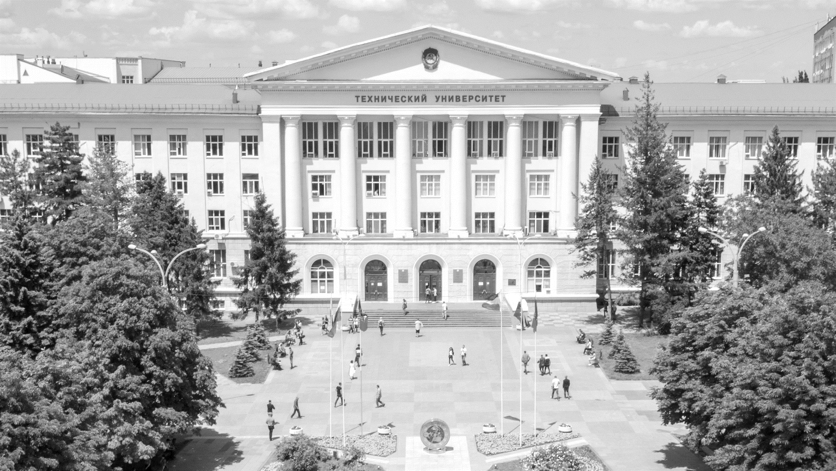
MINISTRY OF SCIENCE AND HIGHER EDUCATION OF THE RUSSIAN FEDERATION
DON STATE TECHNICAL UNIVERSITY
DON STATE TECHNICAL UNIVERSITY
FACULTY “INTERNATIONAL”
www.donstu.ru

Slide 2
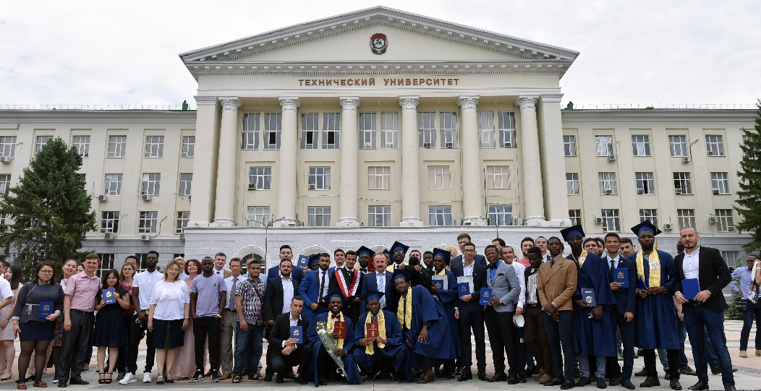
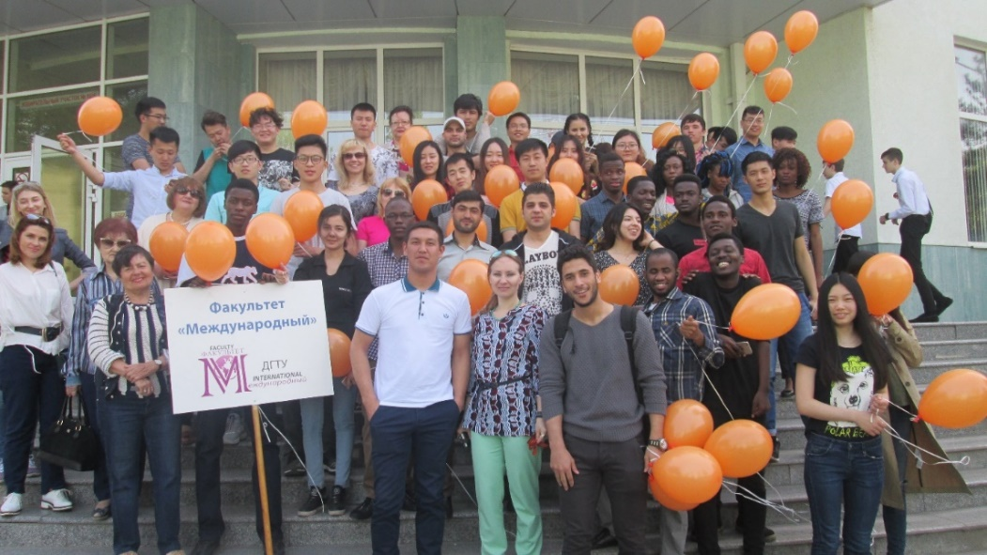
INTERNATIONAL FACULTY – HISTORY AND STATISTICS
45 years
of successful training of foreign citizens for further education in higher education institutions of Russia
16000 +
Students from 1975 .
2019/2020:
548 people from 44 countries
CONTINUED TO STUDY IN:
Don State Technical University
South Federal University
Rostov State Medical University
Rostov State Transport University
Higher School of Economics
First Moscow State Medical University
Russian State Social University
Volgograd State University
Volgograd State Technical University
Krasnodar State Medical University
Kuban State Agrarian University
South Ural State University
DON STATE TECHNICAL UNIVERSITY www.donstu.ru

Slide 3
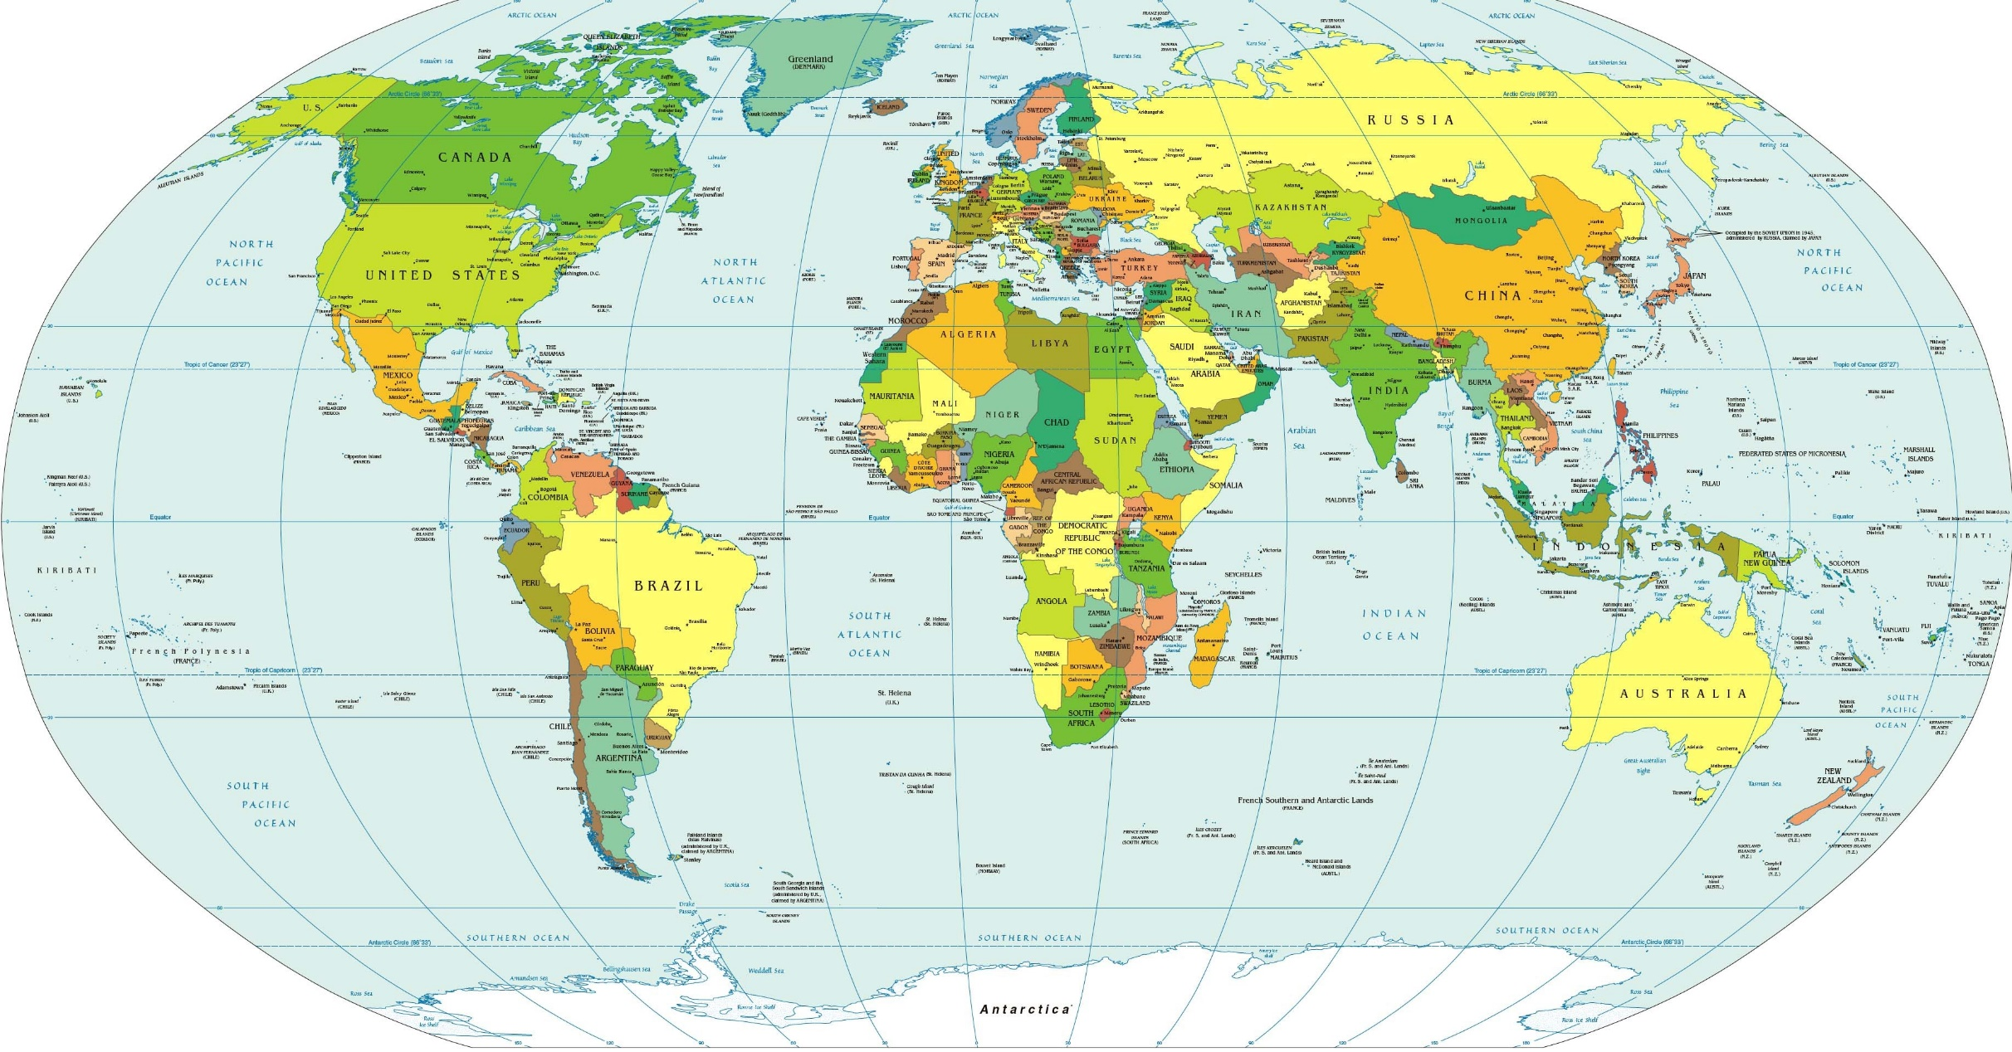
INTERNATIONAL FACULTY - GRADUATES
ИНСТИТУЦИОНАЛЬНОЕ ПАРТНЁРСТВО
ВЗАИМОДЕЙСТВИЕ В СФЕРЕ КУЛЬТУРЫ И СПОРТА
СОЗДАНИЕ ПРОГРАММ ДВОЙНОГО ДИПЛОМИРОВАНИЯ
DON STATE TECHNICAL UNIVERSITY www.donstu.ru

Slide 4
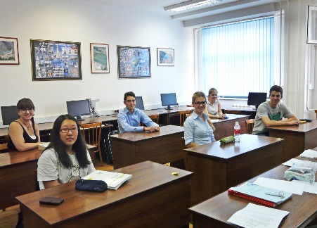
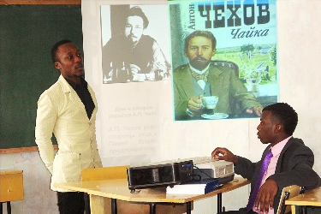
INTERNATIONAL FACULTY
Implements additional educational programs, preparing foreign citizens for studying professional educational programs of various degrees in Russian language
PROGRAM STRUCTURE
Engineering and technical
Natural-science
Economic
Humanitarian
Medico-biological
Russian as a foreign language
+ profiles
CERTIFICATE IN STANDARD FORMAT
ADDITIONAL EDUCATION COURSES
Russian as a foreign language (in accordance with TORFL levels)
Russian language for business
Russian language for engineers
Teaching Russian as a foreign language (from elementary to advanced levels)
HEAD TESTING CENTER
Preparation for a test to obtain an international certificate confirming the level of Russian language proficiency
DON STATE TECHNICAL UNIVERSITY www.donstu.ru

Slide 5
INTERNATIONAL FACULTY
EDUCATION FORMATS
ONLINE
Individual educational plan
Convenient schedule considering time zones
Tutors’ assistance
MIXED
Individual educational plan
A wide range of online courses
Flexible system of getting marks online
OFFLINE
Small groups (maximum 8 people)
Language labs
Science research projects
Buddy service system
Comfortable accommodation
APPLICATION DATES:
FINAL DOCUMENTS:
10 June – 30 October
Certificate in standard format and TORFL /В1 Certificate
BEGINNING DATES:
as groups are completed
(September-November)
TUITION FEE:
FINAL EXAMS:
120 000 RUB
Russian language+ specialized disciplines
DON STATE TECHNICAL UNIVERSITY www.donstu.ru

Slide 6
INTERNATIONAL FACULTY - TEACHERS
DEPARTMENTS:
«RUSSIAN AS A FOREIGN LANGUAGE»
«NATURAL SCIENCE»
DEPARTMENTS HAVE:
4
Doctors of Science
28
PhD
16
Professors
highly qualified teachers who speak foreign languages and have competencies that allow them to conduct training in online format
unique educational and methodological sets ensure the quality of education and comfortable adaptation to the national educational and cultural environment
Who have experience in teaching Russian as a foreign language and other core subjects in leading foreign universities and language centers
9
staff members of Department «RFL»
who are testers of the Head Center for testing Russian as a foreign language
ДОНСКОЙ ГОСУДАРСТВЕННЫЙ ТЕХНИЧЕСКИЙ УНИВЕРСИТЕТ www.donstu.ru

Slide 7
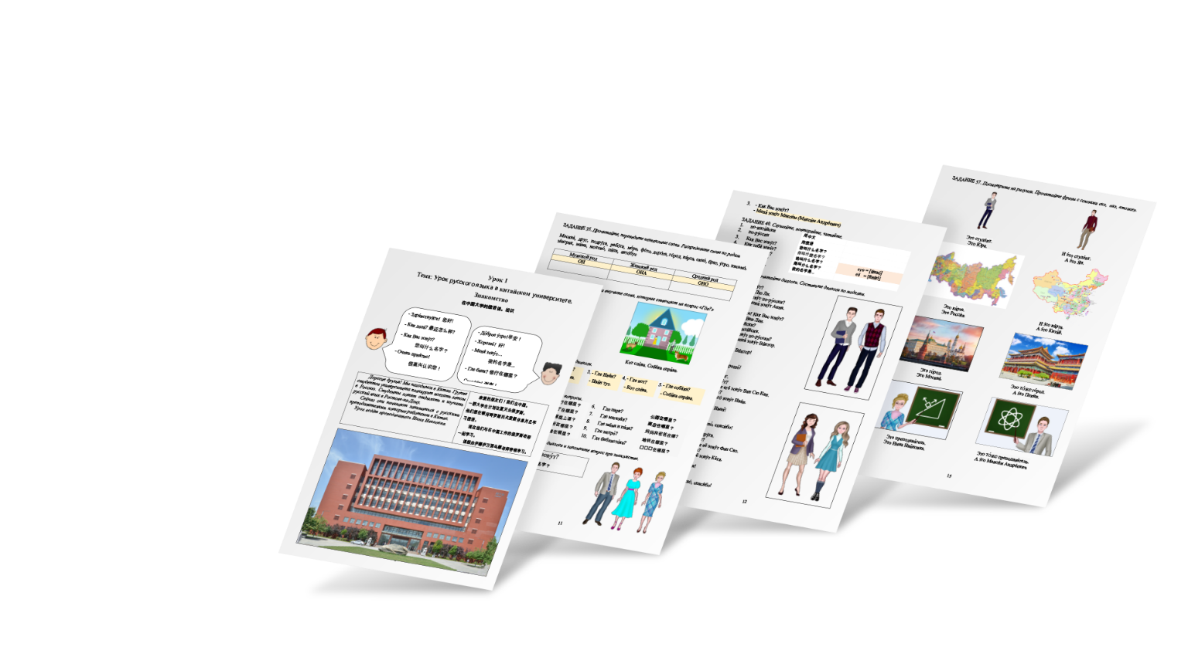
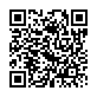
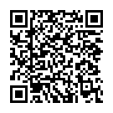
INTERNATIONAL FACULTY - LMS
AUTORSHIP SET FOR STUDYING RUSSIAN AS A FOREIGN LANGUAGE «WE»
communication and activity approach
situational and country-specific principle of content organization
project-oriented technologies of educational and methodical work
new technologies, including augmented reality Vision 2: 0
Chinese, Arabic, French, English versions of the textbook
DON STATE TECHNICAL UNIVERSITY www.donstu.ru

Slide 8
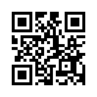
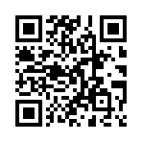
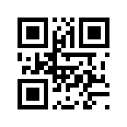
INTERNATIONAL FACULTY -
HIGH QUALITY EDUCATION IN ONLINE FORMAT
convenient enrollment process: submitting applications and documents online using the platform online.donstu.ru
organization of the educational process, including the creation of e-courses for core and additional disciplines, depending on the field of study in LMS DSTU (skif.international.donstu.ru) with automatic testing of students ' knowledge level at various stages of educational process and elements of automated analysis of learning performance
monitoring student satisfaction, the ability to choose teachers and training mode on the platform my.e.donstu.ru
ensuring the quality of education and comfortable training with the subsequent support of admission to higher education institutions of Russia
online.donstu.ru
skif.international.donstu.ru
my.e.donstu.ru
ДОНСКОЙ ГОСУДАРСТВЕННЫЙ ТЕХНИЧЕСКИЙ УНИВЕРСИТЕТ www.donstu.ru

Slide 9
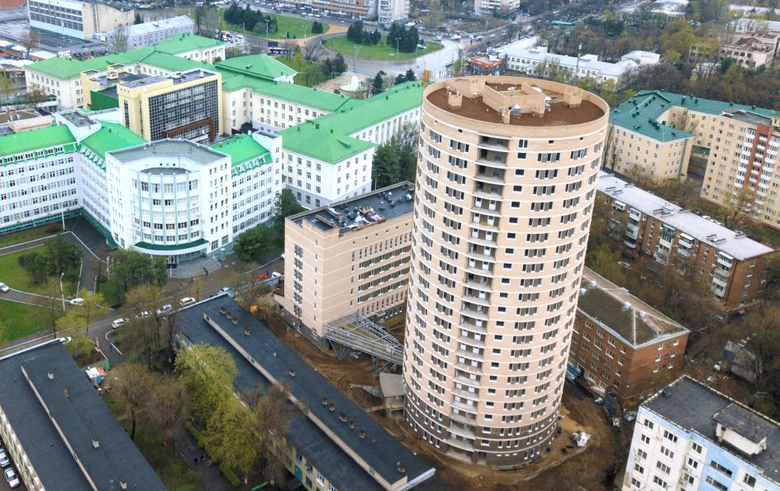
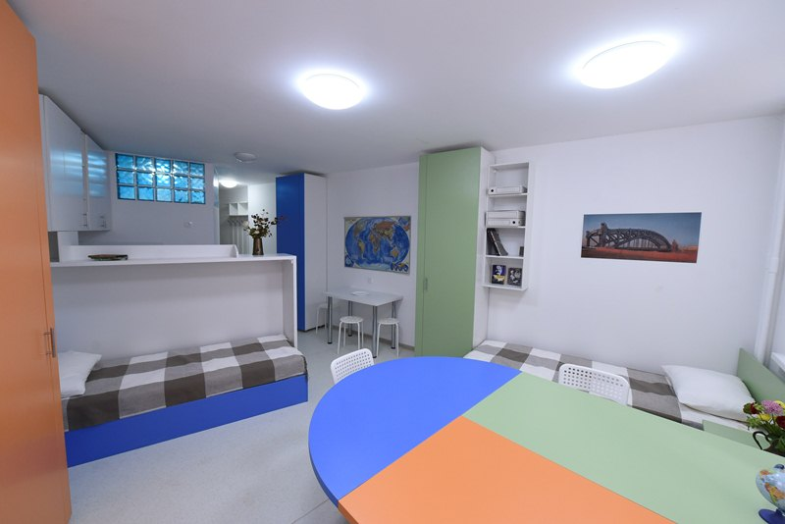
INTERNATIONAL FACULTY - CAMPUS
SCIENTIFIC AND EDUCATIONAL BUILDING (CITY CENTER)
NEW DORMITORIES
ДОНСКОЙ ГОСУДАРСТВЕННЫЙ ТЕХНИЧЕСКИЙ УНИВЕРСИТЕТ www.donstu.ru

Slide 10
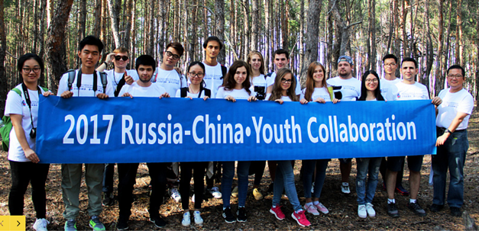
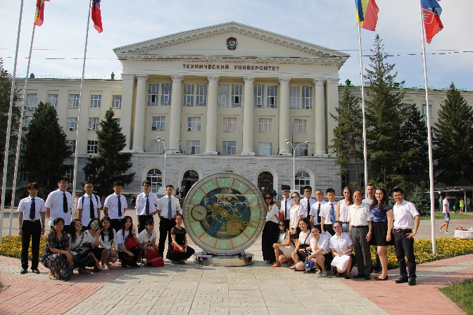
MORE OPPORTUNITIES
INTERTATIONAL STUDETNS’ MEDIAEXPIDITIONS «ROUTES OF THE QUIET DON»
SUMMER SCHOOLS LANGUAGE+
«RENEWABLE ENERGY SOURCES AND GREEN TECHNOLOGIES»
«LOGISTICS AND MANAGEMENT IN ROAD TRANSPORT FIELD»
«URBAN PLANNING AND REDEVELOPMENT : FIFA WORLD CUP»
ДОНСКОЙ ГОСУДАРСТВЕННЫЙ ТЕХНИЧЕСКИЙ УНИВЕРСИТЕТ www.donstu.ru

Slide 11
INTERNATIONAL FACULTY – HOW TO APPLY
7 STEPS
STEP 1
STEP 5
REQUIRED DOCUMENTS:
passport (valid during 1,5 years from you visa dates
migration card with a border crossing mark
certified originals of previous education certificates with inserts, and their notarized translations
6 photos of 30х40 mm size
Fil in the form on website www.donstu.ru
prepare a list of documents
STEP 2
wait for getting invitation letter from DSTU
STEP 6
after arriving at DSTU register in International Office
STEP 3
apply for Russian visa
STEP 7
STEP 4
pay tuition fee, пройдите undertake medical check up, buy medical insurance
confirm your arrival to DSTU 10 days before coming to Russia
ДОНСКОЙ ГОСУДАРСТВЕННЫЙ ТЕХНИЧЕСКИЙ УНИВЕРСИТЕТ www.donstu.ru

Slide 12
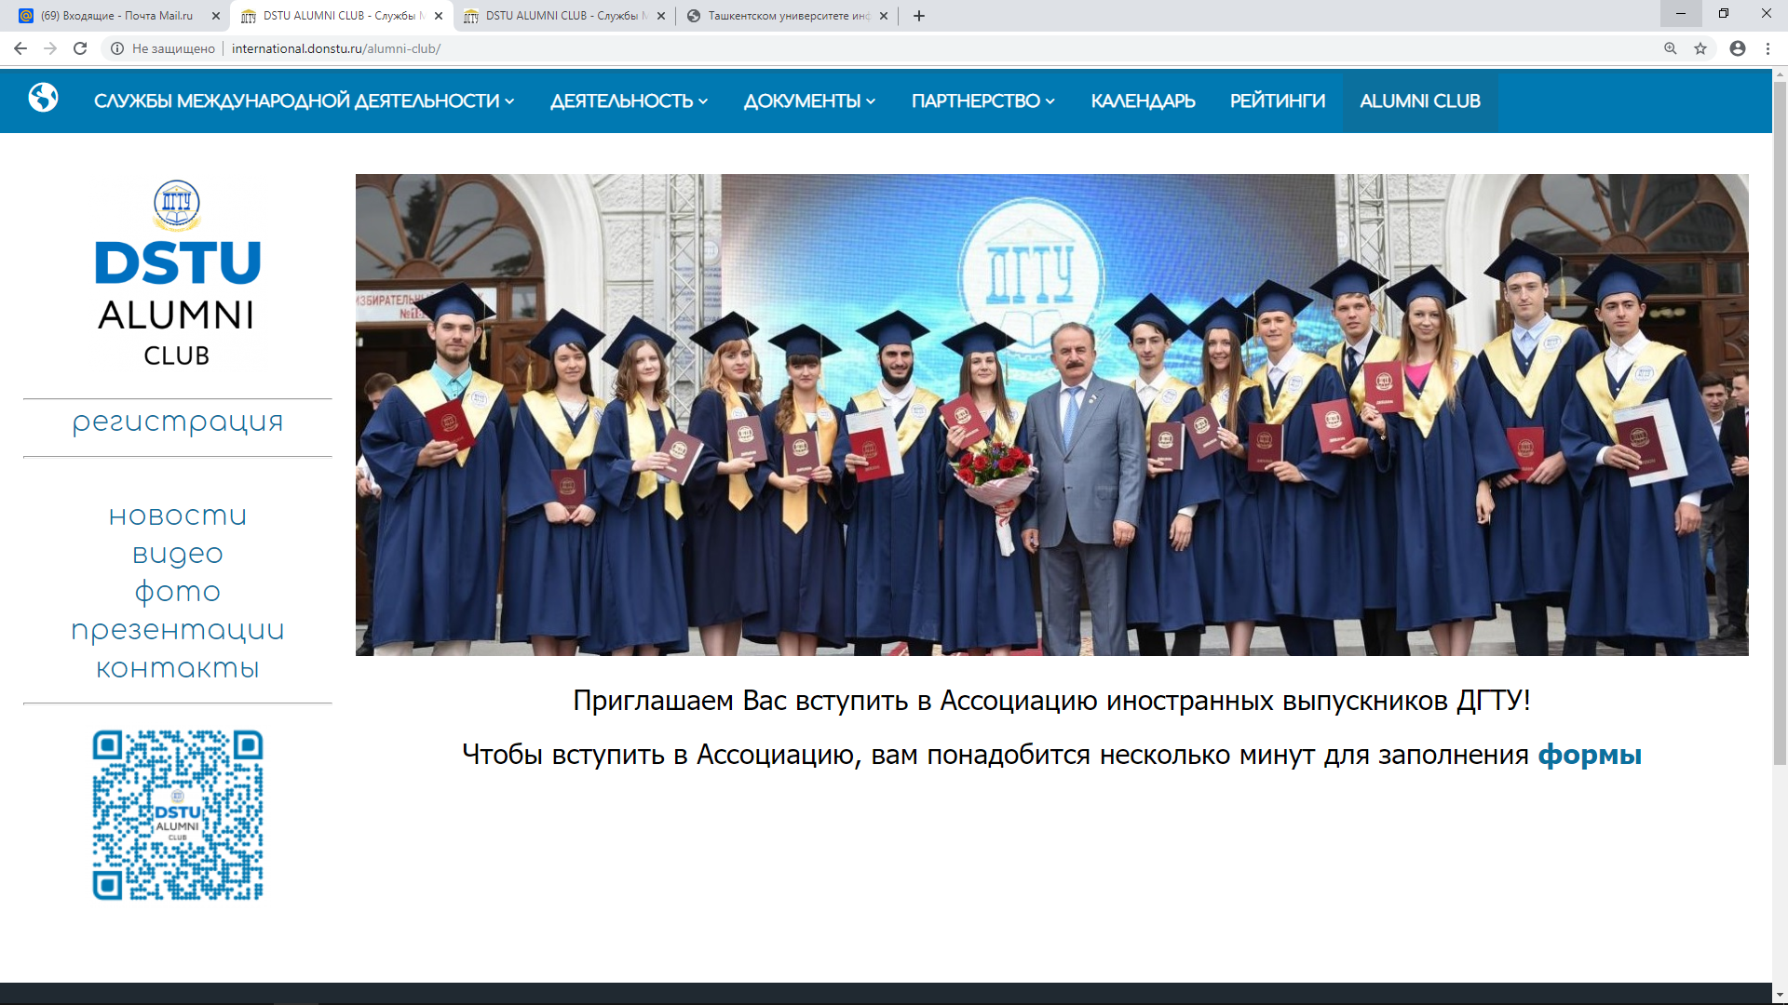
DSTU ASSOCIATION OF FOREIGN GRADUATES
We welcome you to join DSTU Association of Foreign Graguates! In order to join us, fill in the form, please
international.donstu.ru/alumni-club
ДОНСКОЙ ГОСУДАРСТВЕННЫЙ ТЕХНИЧЕСКИЙ УНИВЕРСИТЕТ www.donstu.ru

Slide 13
CONTACT INFORMATION
NIINA NOVIKOVA
INTERNATIONAL FACULTY
+7 (863) 238-17-83
spu-48@donstu.ru
www.donstu.ru

